Slide 1


Data Masters Our goal is to enable you to use all of your data
to drive business excellence and growth
Team Members
Business Analyst: Dana Jesun Kim
Project Manager: Rebekah Gonzalez
Data Scientist: Omer Orhan
Data Scientist: Kirk Goodall

Slide 2

About Data Master
Our Company, Data Masters, shall implement a solution aimed at rolling out best-in-class tools with access to a broad array of data while ensuring the highest integrity and security.
Notes:
2

Slide 3

About Data Master
Scalable
The system will support geographically dispersed portfolios and growth
Common toolset
Development tools with diverse functionality for data analysts
Dashboards, metrics and decision models for business productivity
Platform
Multi-source data to provide a comprehensive spectrum
Analytical tools for deep investigation into risk and marketing research
Credit scores, credit card usage, all-inclusive retail patterns and social media details
Notes:
Scalable – regardless of location and size of business
Common toolset- different/ affordable toolset to provide decision model for maximize business productivity
Platform – comprehensive spectrum of your business with deep understanding with different source datas

Slide 4
AMZ Bank Challenges Highlights
About AMZ Bank
Philosophy High standards and Advanced service
7th largest lender in terms of assets
Network of over 400 branches in Asia Pacific
Relationships with 1000 banks in 70 countries
New Vision
Ultra-Modern and Data driven for business excellence.

Slide 5
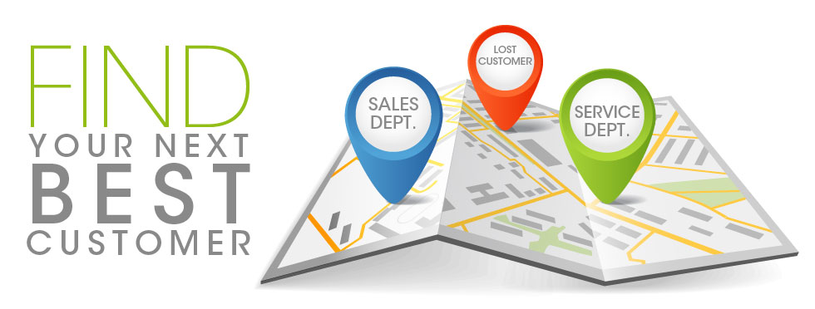

AMZ Bank Challenges Highlights
Project Goals
Find new customers
Target the marking for high value customers
Customer Retention
Reduce loss of customers to their competition
Wish to reward active and paying customers

Slide 6

Big Data can help YOU
become the ‘Go-To’ bank
Getting people to want to be your customers because of the superior service.
Provide multiple services to make it easy and convenient when they use your product.
Adding values to customer’ lives by providing products and services that go beyond commodity features – personalize
Maximize company’s profit by targeting right customers with right product

Slide 7
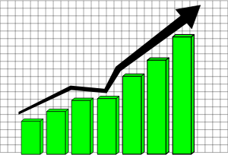




Key Value Areas of Customers
Segmentation and Monitoring Identify, target and track performance of Credit Cards. Run detailed segmentation models and visualize results. | Transaction Analysis Monitor, track and take action on transaction data in real-time; better service, meet the needs of the customers.
Customer Sentiment Analysis Proactively respond to ‘voice of the Customer.’ Capture web traffic, surveys, social media and phone calls. | Payment Channels Data Capture and analyze data from new payments to aggregate and sell to third parties and better inform marketing branches.
Sales and Marketing
Better Fraud and Security
Better Risk Evaluation
Segmentation & Campaigns
360 View of Relationship
Customer Sentiment Analysis
Large Scale Branch Reporting

Slide 8
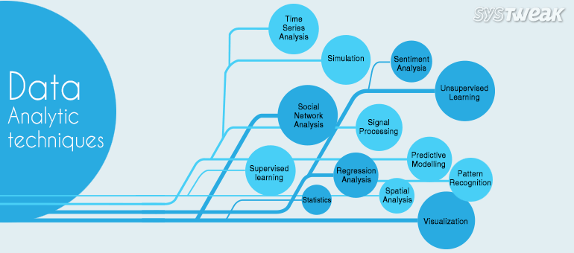

Key Trends

Slide 9

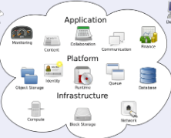
Project Management
Business Stakeholders
Data Masters
Business Analyst
AMZ Bank
Data
Engineer
Project Manager
Tech
Support
3rd Party Cloud Vendor
Data
Scientist
Data
Scientist
Notes:
9

Slide 10
Project Lifecycle
Planning : Key Decisions are Made
BUSINESS
Define Requirements
Cloud Vendor SLA
Roadmap, Scope, Budget, Schedule and Resources
Data Analytics Dashboard
Identify Business KPIs for success, value, resource transition
TECHNICAL STAFF
Technical Requirements
Implement Development, Test and Production Framework
Design Specifications
Identify Data Sources and Data Capture
Identify Data Processing and Visualization
Notes:
10

Slide 11
Project Lifecycle
Execution : Work Takes Place
TECHNICAL STAFF
Development and Testing
Partner with Cloud Operations Vendor
Functioning Data Capture, Analytics and Visualization Interface
Code Test and UAT
Phased Pilot Implementation
Full Deployment
PROJECT MANAGEMENT
Monitor and Control
Communication at all levels: Reporting and Website
Monitor Project Health and Issue Control
Technical Support Training
End-User Training on Tools and Interface
Notes:
11

Slide 12
Project Lifecycle
Project Close : Fully Operational
Operations and Services Successfully Online
Resources Trained
KPI Success Evaluation
Project Evaluation, Reflection and Final Documentation
Quality Assurance Policy in Effect
Broad Communiqué with Final Project Closure
Notes:
12

Slide 13
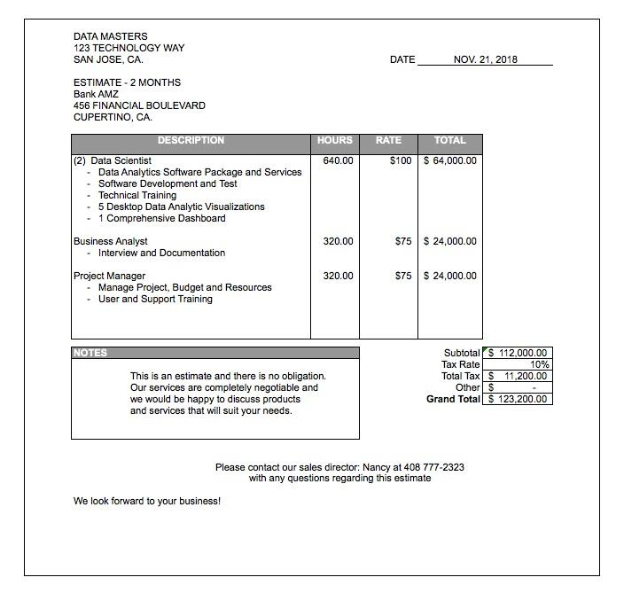
Project Estimate
Notes:
13

Slide 14
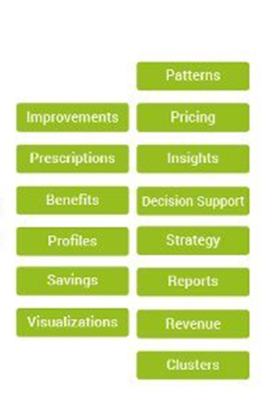

















Recommended Tech Stacks
Notes:
14

Slide 15
Architecture Package Selection
Web Logs
Phone Apps
Social Media
Call Logs
ZOO KEEPER
FLUME
HBase
Cassandra
Hive / HBase
Pig / HBase
Python
R
Hortonworks - Cloudera

Slide 16
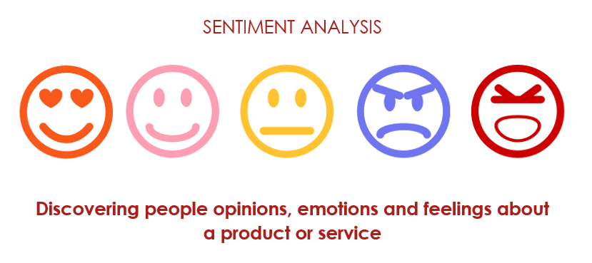


Project Architecture Example
This Is How Twitter Sees The World with Sentiment Analysis.
Twitter - 330 million+ active monthly users
Facebook - 2.2 billion+ monthly active users

Slide 17
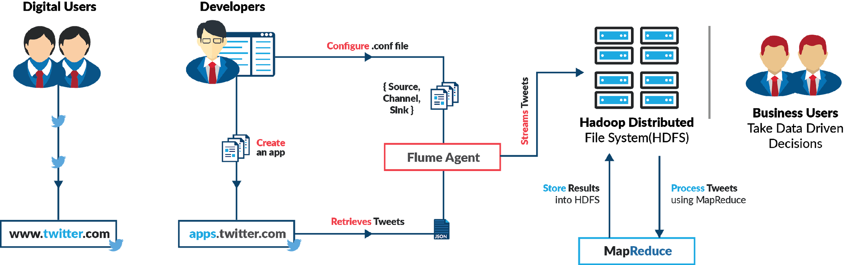
Project Architecture Example

Slide 18
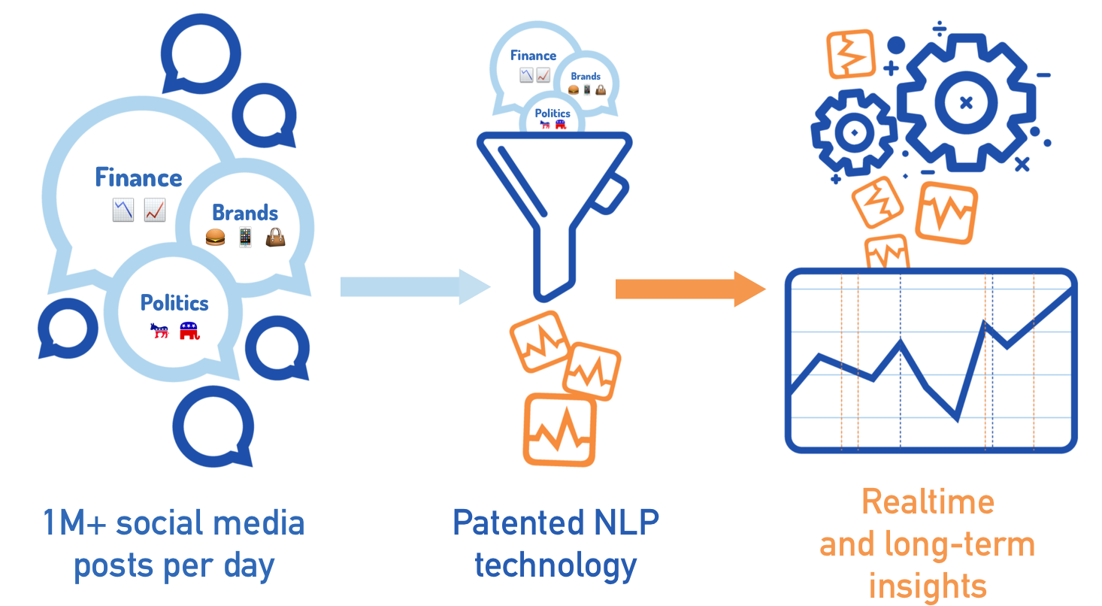
Solution Design Mockup
Source: Twitter and Facebook's API
Flume- transfer the data into HDFS
Hive-highly performance script for sentiment analysis
Hive produces a list that shows based on attitude for countries, states, and products

Slide 19
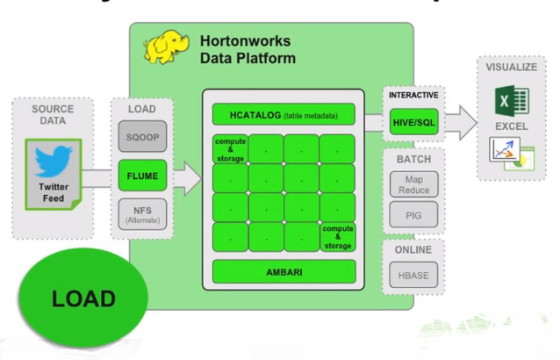
Analysis with Hive

Slide 20
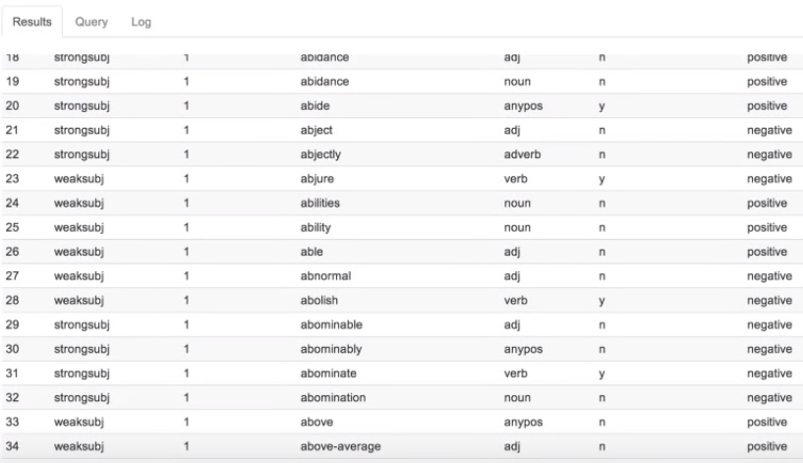
Dictionary List Words
4000 negative and positive words

Slide 21
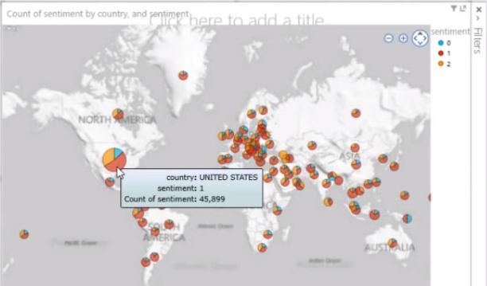
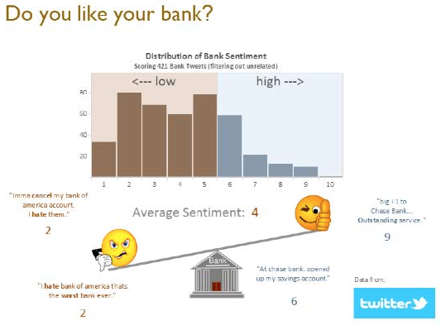
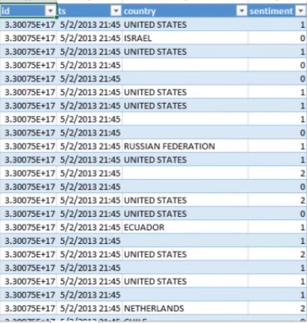
Output

Slide 22
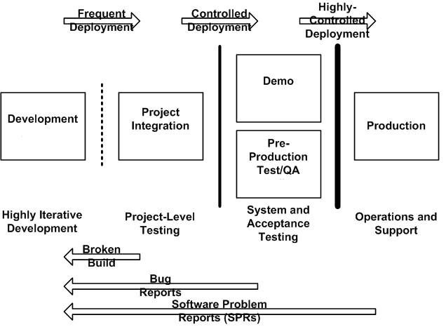
Deployment Strategy
Notes:
22

Slide 23
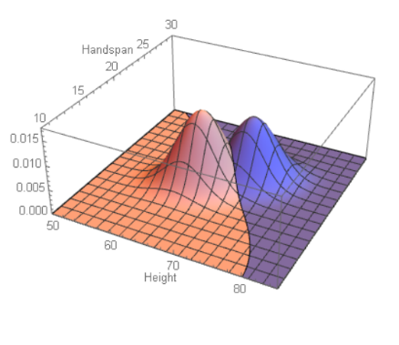
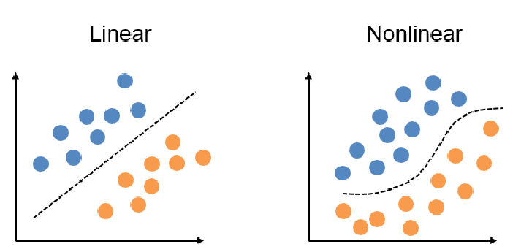
Analytics
Decision
Post Processing in R and Python
Predict customer behavior (Linear & Bayesian Classification) - Python
Predict or estimate a value (Regression) - R
Segment a population (Bayesian Clustering) - Python
Identify business problem factors (Attribute Importance) - Python
Find profiles of targeted people or items (Decision Trees) – R & Python
Determine important relationships (Associations) - Python
Find fraudulent or “rare events” (Neural Network) - Python
Bayesian Probability
Linear & Bayesian Classifiers
Notes:
Data Mining can provide valuable hidden patterns
•Predict customer behavior (Linear & Bayesina Classification) - Python
•Predict or estimate a value (Regression) - R
•Segment a population (Bayesian Clustering) - Python
•Identify factors more associated with a business problem (Attribute
Importance) - Python
•Find profiles of targeted people or items (Decision Trees) – R & Python
•Determine important relationships and “market baskets” within the
population (Associations) - Pyhon
•Find fraudulent or “rare events” (Anomaly Detection)

Slide 24
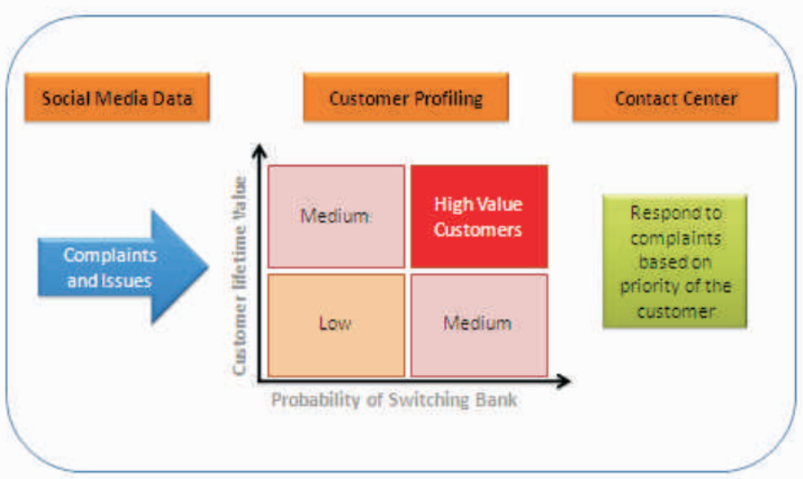
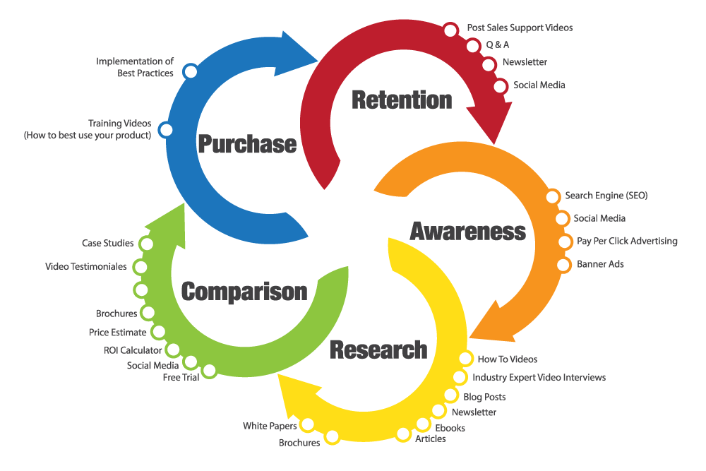
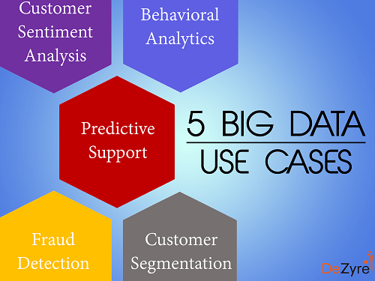
Proposed Solution Benefits

Slide 25

Summary
VOCAL VOICES, VALUABLE CONNECTIONS
Compared to the average internet user, people who create content on these sources are...
+55%
more likely to provide
brands ideas for a new
product/design.
+49%
more likely to share a brand’s post on social media.
+25%
more likely to advocate for brands that they have a personal / one-to-one
relationship with.
Notes:
lWhen you see the tech trends shift, you had better move quickly, or someone else will beat you

Slide 26

Any Questions?
Notes:
26

Slide 27
References
http://www.rolta.com/wp-content/uploads/pdfs/resources/Banking-Analytics-Brochure.pdf
http://www.recoverydecisionscience.com/sentiment-analysis-could-have-prevented-the-askjpm-fiasco/
https://www.knowledgehut.com/blog/big-data/5-best-data-processing-frameworks
https://techseen.com/2016/06/16/ortec-big-data-portal/
https://docs.microsoft.com/en-us/azure/architecture/data-guide/big-data/
https://blogs.systweak.com/2016/11/an-insight-into-26-big-data-analytic-techniques-part-2/
Notes:
27

Slide 28
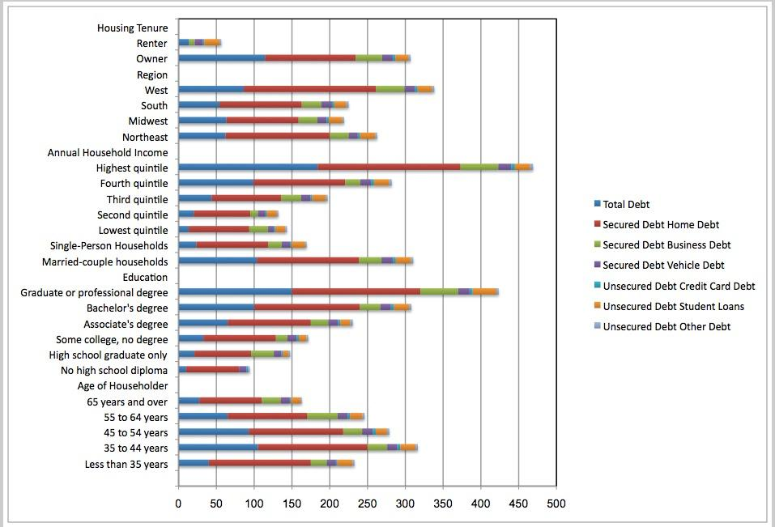
Debt of Households in the US

